Slide 1
E-COMMERCE SALES ANALYSIS
DecodeLabs Internship Project 4
Power BI Dashboard & Business Insights
Poweide Abigail Edonkumoh
Data Analyst • Medical Laboratory Scientist
DecodeLabs Internship • Project 4 • Power BI

Slide 2
Project Overview
Turning e-commerce transaction data into clear, actionable insights.
• Built an interactive e-commerce sales dashboard in Microsoft Power BI.
• Focused on sales performance, orders, products, payment methods, referral sources and order status.
• Used the cleaned dataset prepared during the earlier project stage.
• Designed the dashboard to make key trends and business metrics easy to understand at a glance.
DecodeLabs Internship • Project 4

Slide 3
Analysis Objectives
• Measure overall sales, orders, units sold and average order value.
• Track monthly sales performance.
• Identify products contributing the most revenue and units sold.
• Understand order-status and payment-method patterns.
• Evaluate referral sources and coupon-code performance.
• Turn the findings into practical business recommendations.
DecodeLabs Internship • Project 4

Slide 4
Data & Tools
• Dataset: 1,200 e-commerce orders covering 2023–2025.
• Key fields: Date, Product, Quantity, UnitPrice, TotalPrice, OrderStatus, PaymentMethod, ReferralSource and CouponCode.
• Power BI was used for data modeling, DAX measures and visualization.
• Created Year, Month Name and Month Number fields for time analysis.
• Added slicers for year, date, product, payment method, order status and referral source.
DecodeLabs Internship • Project 4

Slide 5
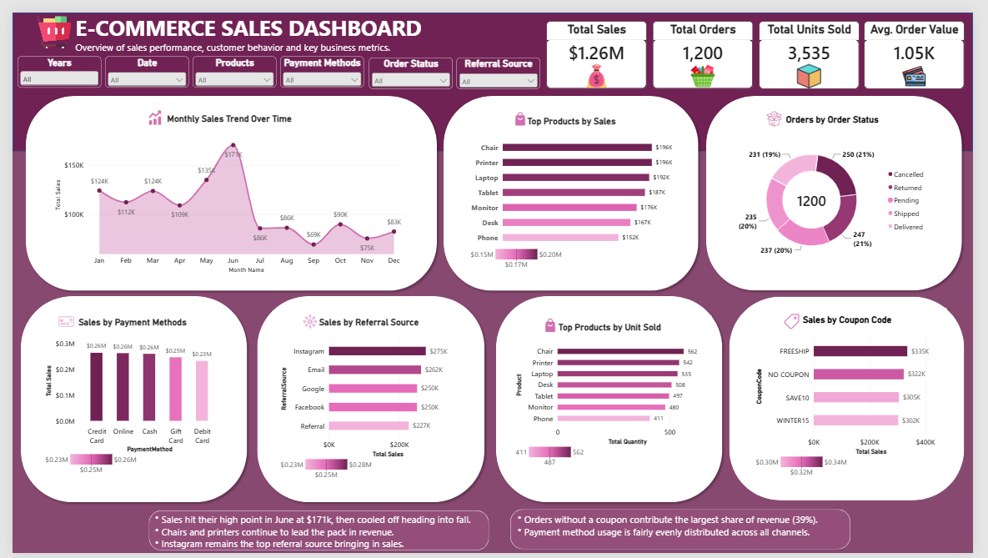
Final Power BI Dashboard
Interactive overview of sales performance and customer/order behavior.
DecodeLabs Internship • Project 4 • Final Dashboard

Slide 6
Key Performance Indicators
A quick snapshot of overall performance.
$1.26M
Total Sales
1,200
Total Orders
3,535
Total Units Sold
$1.05K
Average Order Value
• Sales reached about $1.26M across the dataset.
• The 1,200 orders generated 3,535 units sold.
• Average order value was approximately $1.05K.
• These KPIs provide the baseline for the deeper visual analysis.
DecodeLabs Internship • Project 4

Slide 7

Monthly Sales Trend
The chart shows how sales moved across the months.
$171K
June peak
$75K
November low
$83K
December
• Sales reached their highest point in June at approximately $171K.
• After June, sales dropped sharply in July and stayed lower through the later months.
• The monthly variation can support seasonal planning and campaign timing.
DecodeLabs Internship • Project 4

Slide 8

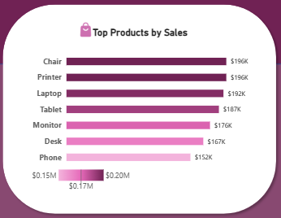
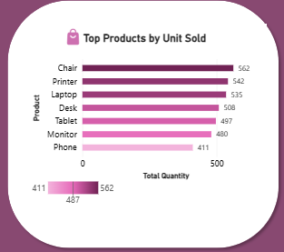
Product Performance
Revenue and volume tell two different parts of the product story.
• Highest sales contributors: Chair — $196K; Printer — $196K; Laptop — $192K; Tablet — $187K.
• Top units sold: Chair — 562; Printer — 542; Laptop — 535; Desk — 508.
• This shows why revenue and units sold should be viewed together when evaluating products.
DecodeLabs Internship • Project 4

Slide 9

Order Status Distribution
The donut chart breaks down the 1,200 orders by status.
1,200
Total Orders
• Delivered and shipped orders form a large share of activity.
• Cancelled, returned and pending orders are areas worth monitoring.
• The status breakdown can help identify fulfillment and customer-experience issues.
250
Cancelled
DecodeLabs Internship • Project 4

Slide 10

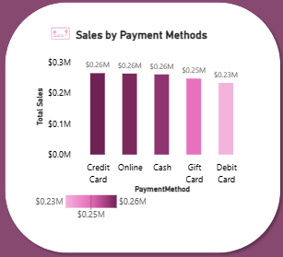
Payment Method Performance
Sales are relatively balanced across the main payment methods.
• Credit Card — approximately $0.26M
• Online — approximately $0.26M
• Cash — approximately $0.26M
• Gift Card — approximately $0.25M
• Debit Card — approximately $0.23M
• No single payment method dominates.
• Maintaining multiple payment options can reduce checkout friction.
• Payment performance should be monitored alongside order volume and customer preferences.
DecodeLabs Internship • Project 4

Slide 11

Referral Source Performance
Which channels are bringing in the most sales?
$275K
Instagram
$262K
Email
$250K
Google
• Instagram is the leading referral source in the dashboard.
• Email and Google also contribute strongly to sales.
• These channels are good candidates for continued testing and targeted marketing investment.
DecodeLabs Internship • Project 4

Slide 12

Coupon Code Performance
Coupon usage reveals an important revenue pattern.
$335K
FREESHIP
$322K
NO COUPON
$305K
SAVE10
• FREESHIP generated the highest sales among the displayed coupon categories.
• Orders without a coupon still contributed a large share of revenue.
• Coupon campaigns should be evaluated using profitability as well as revenue.
DecodeLabs Internship • Project 4

Slide 13

Key Insights
What stands out from the dashboard?
• June was the strongest month, reaching approximately $171K in sales.
• Chair and Printer were the leading products by sales, while Chair also led units sold.
• Instagram was the strongest referral source.
• Payment-method sales were relatively balanced.
• FREESHIP was the top displayed coupon category by sales.
• The order-status mix highlights cancellation/return activity that deserves attention.
DecodeLabs Internship • Project 4

Slide 14

Recommendations
Turning the analysis into next steps.
• Plan promotions and inventory around high-performing periods, especially the June peak.
• Prioritize high-revenue products such as Chair, Printer, Laptop and Tablet in marketing and stock planning.
• Continue investing in Instagram while testing ways to grow other strong referral channels.
• Review cancelled and returned orders to understand the main causes and reduce avoidable losses.
• Measure coupon campaigns using both sales and profit/margin to identify genuinely effective offers.
DecodeLabs Internship • Project 4

Slide 15
From Data to Decisions
A Power BI dashboard that turns e-commerce transactions into a clear business story.
• This project strengthened my ability to build interactive dashboards, create DAX measures and communicate insights visually.
• It was a valuable final project in my DecodeLabs Internship journey.
THANK YOU
Poweide Abigail Edonkumoh • DecodeLabs Internship • Project 4

